Slide 1
INTEGRATED PHYSIOLOGY OF THE CARDIORESPIRATORY SYSTEM
From Cellular Respiration to Systemic Integration
Kola Akinlabi

Slide 2
Learning Objectives
Explain the mechanics of pulmonary ventilation and gas exchange
Describe cardiac electrophysiology and the cardiac cycle
Analyze cardiovascular hemodynamics and blood pressure regulation
Integrate respiratory and cardiovascular control mechanisms
Apply physiological principles to clinical scenarios

Slide 3
The Oxygen Delivery System
Primary Function
Deliver O₂ to tissues, remove CO₂ from body
Three Integrated Components:
Respiratory System: Gas exchange interface
Cardiovascular System: Transport system
Blood: Carrier medium
Key Performance Metrics:
Cardiac Output (CO): 5-6 L/min
Oxygen Consumption (VO₂): 250 mL/min (rest)
Ventilation (V̇E): 6-8 L/min (rest)

Slide 4
SECTION 1
RESPIRATORY PHYSIOLOGY

Slide 5
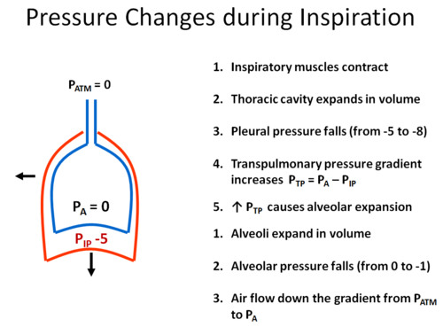
Pulmonary Ventilation:
The Physics of Breathing
Pressure Gradients Drive Air Flow:
Pₐₗᵥ < Pₐₜₘ → Inspiration (air in)
Pₐₗᵥ > Pₐₜₘ → Expiration (air out)
Muscle Actions:
Inspiration: Diaphragm contracts (75%), external intercostals
Expiration: Passive (quiet breathing), Active (exercise) - internal intercostals, abdominals
Key Pressures:
Atmospheric: 760 mmHg
Intrapleural: 756 mmHg (negative pressure)
Alveolar: Varies with breathing cycle

Slide 6
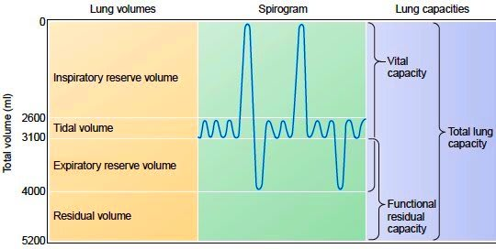
Quantifying Ventilation
Volumes (Non-overlapping):
Tidal Volume (TV): 500 mL
Inspiratory Reserve Volume (IRV): 3000 mL
Expiratory Reserve Volume (ERV): 1100 mL
Residual Volume (RV): 1200 mL
Capacities (Combinations):
Total Lung Capacity (TLC): 6.0 L = RV+ERV+TV+IRV
Vital Capacity (VC): 4.6 L = ERV+TV+IRV
Functional Residual Capacity (FRC):
2.3 L = RV+ERV
Inspiratory Capacity (IC):
3.5 L = TV+IRV

Slide 7
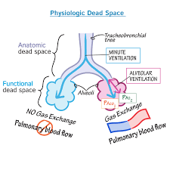
Effective vs. Wasted Breathing
Alveolar Ventilation (Vₐ): Air reaching gas exchange areas
Vₐ = (TV - Dead Space) × Respiratory Rate
Normal: ~4.2 L/min (at rest)
Dead Space:
Anatomical: Conducting airways (~150 mL)
Alveolar: Ventilated but non-perfused alveoli
Physiological: Anatomical + Alveolar
Clinical Correlation: Increased dead space in pulmonary embolism, COPD,

Slide 8
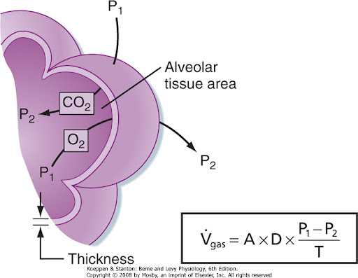
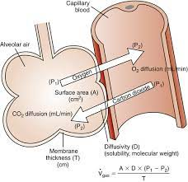
The Alveolar-Capillary Membrane
Fick's Law of Diffusion:
Rate ∝ (Surface Area × ΔPressure × Solubility) / (Thickness × √MW)
Partial Pressures (Resting):
Alveolar: PₐO₂ = 100 mmHg, PₐCO₂ = 40 mmHg
Arterial: PaO₂ = 95 mmHg, PaCO₂ = 40 mmHg
Mixed Venous: Pv̄O₂ = 40 mmHg, Pv̄CO₂ = 46 mmHg
Diffusion Capacity:
O₂: ~21 mL/min/mmHg
CO₂: 20× faster than O₂ (high solubility)

Slide 9
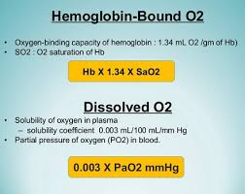
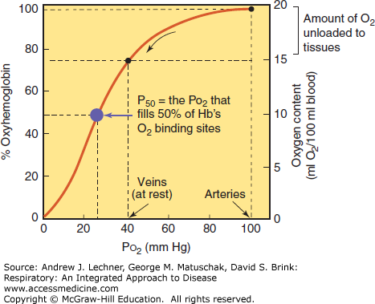
How Oxygen Travels
Dissolved O₂: Minimal (0.3 mL/dL at PaO₂ 100 mmHg)
Hemoglobin-bound O₂: Primary transport (20.1 mL/dL)
1 g Hb binds 1.34 mL O₂
Normal Hb: 15 g/dL × 1.34 = 20.1 mL O₂/dL
Oxygen Content Equation:
CaO₂ = (1.34 × Hb × SaO₂) + (0.003 × PaO₂)
Oxyhemoglobin Dissociation Curve:
Sigmoidal shape (cooperative binding)
P₅₀: 26.7 mmHg (normal)

Slide 10
CO₂ Transport in Blood – Mechanisms
Three Forms of CO₂ Transport:
1. Bicarbonate (70%)
- CO₂ enters RBCs and is converted by carbonic anhydrase
- CO₂ + H₂O ⇌ H₂CO₃ ⇌ H⁺ + HCO₃⁻
- HCO₃⁻ enters plasma, H⁺ is buffered by Hb
2. Carbamino Compounds (23%)
- CO₂ binds directly to haemoglobin
- Binding strongest when Hb is deoxygenated
3. Dissolved CO₂ (7%)
- Transported in plasma
- Measured as PaCO₂ on blood gas (4.7–6.0 kPa)

Slide 11
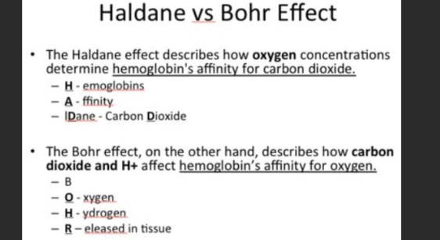
Key Concepts – Chloride Shift, Haldane Effect, CO₂ Curve
Haldane Effect
Deoxygenated haemoglobin carries more CO₂
When Hb releases oxygen in the tissues:
It becomes a better buffer for H⁺
It binds CO₂ more readily
Promotes formation of bicarbonate
In the lungs:
Oxygen binds Hb
Hb releases CO₂
CO₂ is exhaled
✅ The Haldane effect makes CO₂ unloading in the lungs more efficient
✅ It complements the Bohr effect (which works in reverse for O₂)
Chloride Shift (Hamburger Phenomenon):
- HCO₃⁻ leaves RBC
- Cl⁻ enters to maintain electroneutrality
- Reverses in lungs
Haldane Effect:
- Deoxygenated Hb carries more CO₂
- Oxygenation in lungs releases CO₂
CO₂ Dissociation Curve:
- Linear relationship
- No saturation
- Reflects dissolved + bicarbonate transport

Slide 12
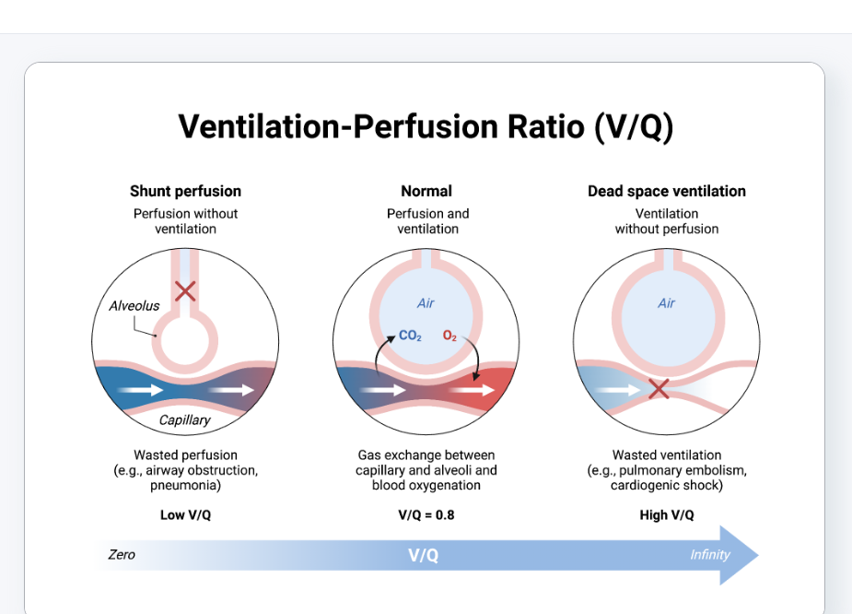
The Perfect Balance
Ideal Ratio: V̇/Q̇ = 0.8 (Alveolar ventilation 4.2 L/min, perfusion 5 L/min)
Regional Variations:
Apex: V̇/Q̇ > 1 (High ventilation, lower perfusion)
Base: V̇/Q̇ < 1 (High perfusion, moderate ventilation)
Pathophysiology:
Shunt (V̇/Q̇ = 0): Perfused but not ventilated (pneumonia)
Dead Space (V̇/Q̇ = ∞): Ventilated but not perfused (PE)

Slide 13
SECTION 2: CARDIOVASCULAR PHYSIOLOGY

Slide 14
The Heart's Electrical Symphony
Action Potential Phases:
Fast Response (Ventricular):
0: Rapid depolarization (Na⁺ in)
1: Early repolarization (K⁺ out)
2: Plateau (Ca²⁺ in, K⁺ out)
3: Repolarization (K⁺ out)
4: Resting (-90 mV)
Pacemaker Cells (SA/AV): Slow depolarization (Phase 4)
Conduction Pathway:
SA node → Atria → AV node → Bundle of His → Bundle branches → Purkinje fibers

Slide 15
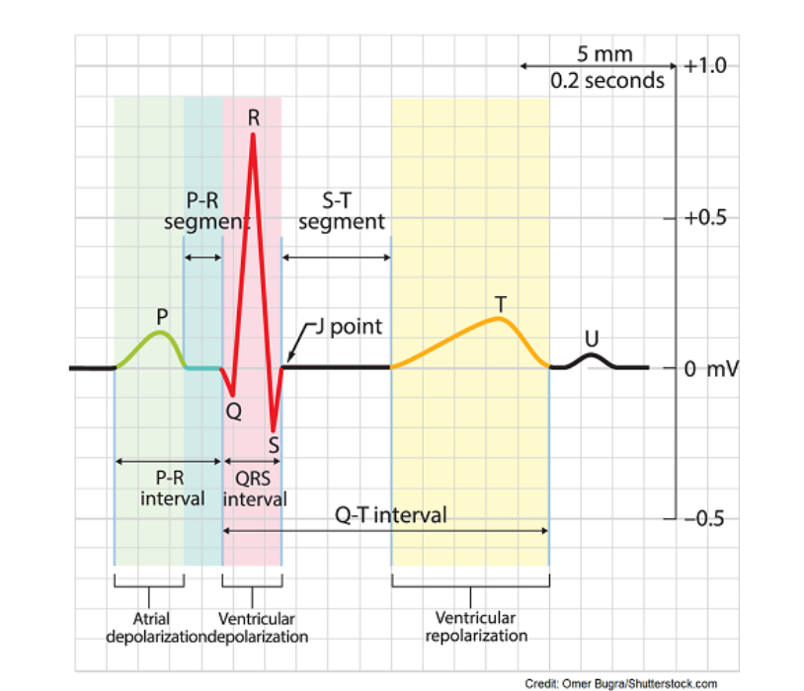
Reading the Heart's Electrical Language
Waves and Intervals:
P wave: Atrial depolarization
PR interval: AV conduction delay (0.12-0.20 s)
QRS complex: Ventricular depolarization (<0.12 s)
ST segment: Ventricular plateau
T wave: Ventricular repolarization
QT interval: Total ventricular activity (HR-corrected)
Mean Electrical Axis: Normal = -30° to +90°

Slide 16
One Heartbeat: From Diastole to Systole
Systole (0.27 s):
Isovolumetric Contraction: Valves closed, pressure rises
Rapid Ejection: Aortic valve opens, blood ejected
Reduced Ejection: Slowing outflow
Diastole (0.53 s):
Isovolumetric Relaxation: Valves closed, pressure falls
Rapid Filling: AV valves open, passive filling
Diastasis: Slow filling
Atrial Systole: "Atrial kick" (25% of filling)

Slide 17
The Heart as a Pump
Cardiac Output (CO) = HR × SV
Normal: 5-6 L/min
Maximum: 20-25 L/min (athletes)
Stroke Volume (SV) Determinants:
Preload: End-diastolic volume (Frank-Starling Law)
Afterload: Aortic pressure (inversely related to SV)
Contractility: Inotropy (Ca²⁺ availability)
Regulation:
Intrinsic: Frank-Starling mechanism
Extrinsic: Autonomic nervous system, hormones

Slide 18
The Physics of Circulation
Ohm's Law for Circulation:
ΔP = Q × R (Pressure = Flow × Resistance)
MAP = CO × TPR
Resistance Determinants (Poiseuille's Law):
R = (8ηL)/(πr⁴) - Radius is dominant factor!
Pressure Distribution:
Arteries: High pressure (100 mmHg)
Capillaries: Exchange pressure (25 mmHg)
Veins: Low pressure reservoir (10 mmHg)

Slide 19
Maintaining the Vital Force
Short-term Regulation (Seconds to Minutes):
Baroreceptor Reflex: Carotid sinus/aortic arch
Chemoreceptors: Hypoxia/hypercapnia
CNS Ischemic Response: Last resort
Intermediate Regulation (Minutes to Hours):
Renin-Angiotensin-Aldosterone System (RAAS)
Capillary Fluid Shift
Long-term Regulation (Days):
Renal-body Fluid System: Pressure diuresis/natriuresis

Slide 20
Where the Action Happens
Starling's Forces:
Net Filtration = (Pc + πi) - (Pi + πc)
Pc: Capillary hydrostatic pressure (32 mmHg arterial end)
πc: Plasma colloid osmotic pressure (25 mmHg)
Pi: Interstitial hydrostatic pressure (-3 mmHg)
πi: Interstitial colloid osmotic pressure (8 mmHg)
Net: +10 mmHg (arterial end, filtration), -8 mmHg (venous end, absorption)

Slide 21
SECTION 3: INTEGRATED CONTROL

Slide 22
Who's Driving Your Breathing?
Medullary Centers:
Dorsal Respiratory Group (DRG): Basic rhythm, inspiration
Ventral Respiratory Group (VRG): Active expiration, forced breathing
Pontine Centers:
Pneumotaxic Center: Limits inspiration, regulates rate
Apneustic Center: Prolongs inspiration (inhibited by pneumotaxic)
Central Chemoreceptors: Ventral medulla, sensitive to [H⁺] (CO₂)
Peripheral Chemoreceptors: Carotid/aortic bodies, sensitive to PaO₂ (<60 mmHg), PaCO₂, [H⁺]

Slide 23
The Perfect Partnership
During Exercise:
Cardiac: ↑HR, ↑SV, ↑CO (up to 5×), redistribution of flow (muscles ↑, splanchnic ↓)
Respiratory: ↑Ventilation, ↑V̇/Q̇ matching, ↑O₂ extraction
Coupled Responses:
Chemoreflex: ↑CO₂ → ↑Ventilation + ↑Sympathetic tone → ↑BP
Baroreflex: ↓BP → ↑Sympathetic → ↑HR + Vasoconstriction
O₂ Delivery Optimization:
Fick Principle: VO₂ = CO × (CaO₂ - CvO₂)

Slide 24
Stress Response Systems
Hypoxia:
Acute: Hyperventilation, tachycardia, peripheral vasoconstriction
Chronic: ↑Hb, ↑2,3-DPG, angiogenesis
Hemorrhage:
Stage 1: ↑Sympathetic, vasoconstriction, ↑HR
Stage 2: RAAS activation, thirst
Stage 3: Shock, organ failure
Heart Failure:
Compensatory: ↑Sympathetic, ↑RAAS, myocardial hypertrophy
Decompensated: ↓CO, pulmonary edema, organ hypoperfusion

Slide 25
Physiology in Practice
COPD Patient: ↑Airway resistance, ↓Elastic recoil, V̇/Q̇ mismatch, Pulmonary hypertension, Cor pulmonale
Myocardial Infarction: ↓Contractility, ↓CO, Compensatory mechanisms, Potential cardiogenic shock
Pulmonary Embolism: ↑Dead space, ↑Pulmonary resistance, ↓CO, Hypoxemia
Heart Failure: ↓Ejection fraction, ↑Filling pressures, Pulmonary edema, Exercise intolerance

Slide 26
Frontiers in Cardiorespiratory Physiology
Molecular: Hypoxia-inducible factors (HIFs), endothelial mechanotransduction
Biomechanical: Tissue engineering of heart valves, vascular grafts
Digital: Wearable monitoring, AI for ECG interpretation
Therapeutic: Gene therapy for pulmonary hypertension, stem cells for myocardial repair

Slide 27
Essential Takeaways
Ventilation-perfusion matching is critical for efficient gas exchange
Cardiac output is determined by heart rate, preload, afterload, and contractility
Blood pressure is maintained by integrated neural, hormonal, and renal mechanisms
O₂ delivery depends on cardiac, respiratory, and hematological function
Control systems operate on multiple time scales for precise regulation

Slide 28
For Further Study
Textbooks:
Guyton and Hall Textbook of Medical Physiology
Berne & Levy Physiology
West's Respiratory Physiology
Journals: Journal of Applied Physiology, Circulation, American Journal of Respiratory and Critical Care Medicine
Online: Physiology.org, Khan Academy Medicine, Osmosis
Simulations: Physiome Project, HHMI BioInteractive

